Slide 1
Lung Disease Detection
Manjunath D

Slide 2
Abstract
The main aim of the project is
Data collection
Data Preprocessing
We will use convolutional neural network to predict which lung disease does the patient have.
This project is a multiclass classification where input is patient's X-Ray of the lungs and output is name of the lung disease.
The obtained results will be validated .

Slide 3
Introduction
Learning about Lung Diseases and their characterization is one of the most interesting research topics in recent years. With the various uses of medical images in hospitals, pathologies, and diagnostic centers, the size of the medical image datasets is also expanding. To effectively and automatically classify the infected patients is a big challenge.Deep learning techniques have recently achieved an impressive result in the field of computer vision along with Medical Engineering. So, we introduce an efficient lung disease detection method that can detect and classify lung diseases with convolutional neural network.

Slide 4
Literature survey
SL.no | Year | Author | Title | Methodology | Conclusion
[1] | 2021 published in Research Gate | Siddhanth Tripathi ,Sinchana Shetty, Somil Jain, Vanshika Sharma | Lung Disease Detection Using Deep Learning | The proposed model consists of Convolutional layers, ReLU Activations, Pooling layer, and fully connected layer. Last full connected layer which consists of fifteen output units. Each output unit will predict the probability of one of the fifteen diseases. | he average accuracy of 89.77% is achieved for the classification of different diseases

Slide 5
Literature survey
SL.no | Year | Author | Title | Methodology | Conclusion
[2] | 2014 Published in ResearchGate | Geraldo Luis Bezerra Ramalho, Pedro Pedrosa Reboucas Filho, Fatima Nelsizeuma Sombra de Medeiros, Paulo Cesar Cortez | Lung Disease Detection Using Feature Extraction and Extreme Learing Machine | Extracts features from segmented CT images and uses an extreme learning machine(ELM) to classify the lung disease | To integrate clinical decision support systems for pulmonary screening and diagnosis

Slide 6
Literature survey
SL.no | Year | Author | Title | Methodology | Conclusion
[3] | 2020 published in International Conference on Communications and Signal Processing | Binila Mariyam Boban & Rajesh Kannan Megalingam | Lung Diseases Classification based on Machine Learning Algorithms and Performance Evaluation | The input image is analyzed, categorized and classified using ML algorithms such as the MLP, KNN and SVM classifier | For MLP, this classifier acquires 98% accuracy, for SVM accuracy is 70.45% and for KNN accuracy is 99.2%

Slide 7
Literature survey
SL.no | Year | Author | Title | Methodology | Conclusion
[4] | 2021 25th International Computer Science and Engineering Conference (ICSEC) | Y. Mangalmurti and N. Wattanapongsakorn | COVID-19 and Other Lung Disease Detection Using VGG19 Pretrained Features and Support Vector Machine | First,preprocess the images and performed feature extraction using a VGG19 deep-learning model, and then used a Support Vector Machine as the classification model | model obtains great results on binary class classification considering COVID-19 and non-COVID-19 classes with 99.0% accuracy

Slide 8
Problem Statement
To effectively and automatically classify the infected patients is a big challenge to solve this problem Implement a convolutional neural network to detect and classify the lung diseases.The CNN should take X-Ray images of lungs as input and the the output should be the name of the disease.

Slide 9
Objectives
Data collection
Data pre-processing
Implement a CNN to detect and classify the diseases
Experiment with various pre trained models on the internet to get better accuracy or find a good architecture for the convolutional model by trial and error
Minimize the loss and maximize the accuracy of CNN

Slide 10
Application
It is used in medical fields .
It is used as first aid for the patient.
It is used by the radiologists.
It can be used as first step in diagnosis of Lung disease.
These classifiers will help the doctors to prescribe the most effective treatment for a patient.

Slide 11
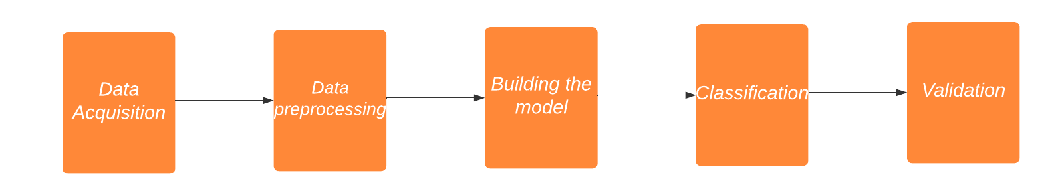
Proposed methodology

Slide 12
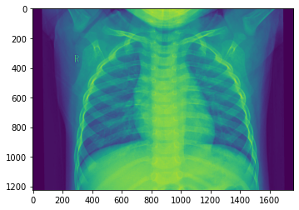
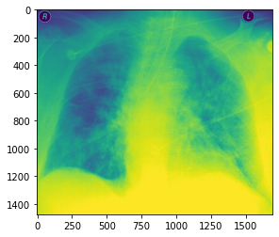
Proposed methodology
Normal lungs
Infected lungs

Slide 13
Conclusion
Currently we have implemented the above proposed methodology on covid–19 X-Ray data-set. This was a binary classification and we were able to achieve a accuracy of 97.50% .Click here to open notebook.
We will be applying the same methodology in multi-class classification to detect multiple lung diseases.

Slide 14
References
[1] Lung Disease Detection Using Deep Learning
[2]Lung disease detection using feature extraction and extreme learning machine
[3] Lung Diseases Classification based on Machine Learning Algorithms and Performance Evaluation
[4] COVID-19 and Other Lung Disease Detection Using VGG19 Pretrained Features and Support Vector Machine

Slide 15
Thank you

